Slide 1




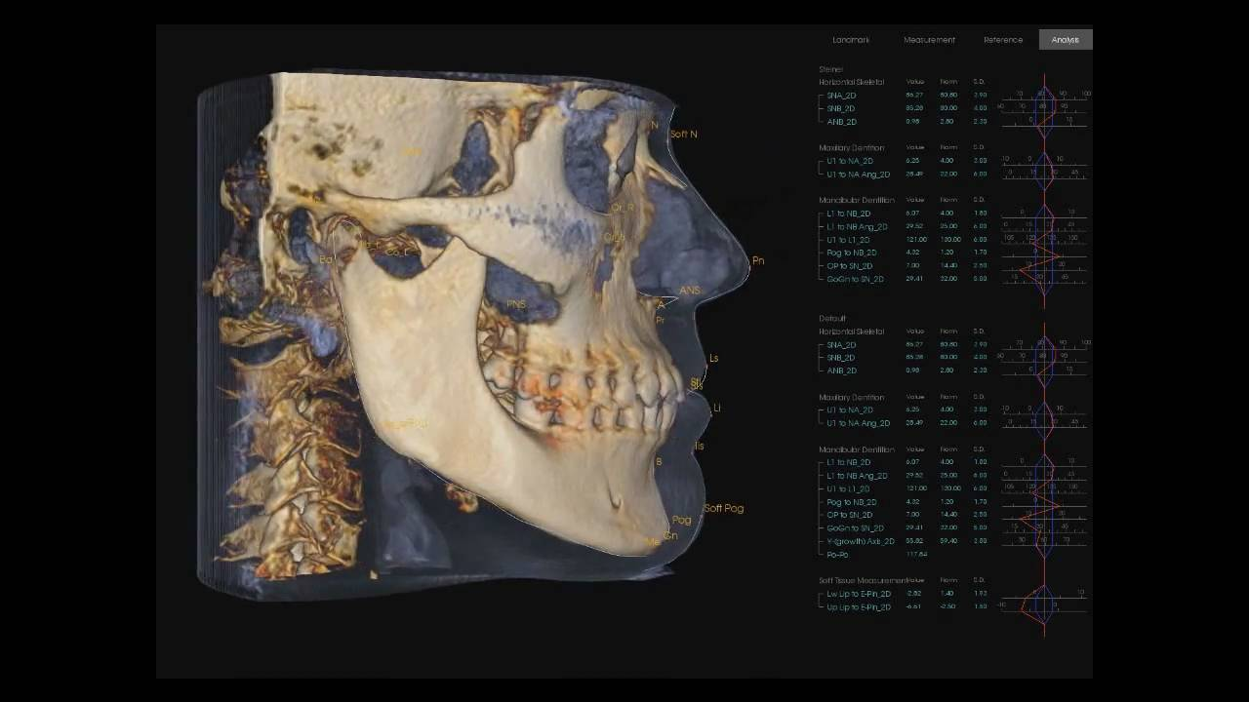
Landmark Localization in 3D Cephalometry using Deep Learning
Xiaoyang WEI
Institut de Biomécanique Humaine Georges Charpak
Supervisors: Laurent Gajny, Gauthier Dot, Thomas Schouman , Philippe Rouch

Slide 2
1.Clinical Background

Slide 3
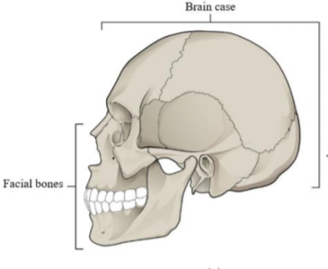
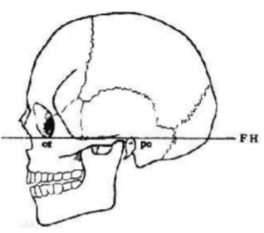
Skull anatomy
Orbital left
Porion left/right
Frankfurt horizontal plane (FH) used clinically to assist in head positioning.
[1] “7.2skull-anatomyandphysiology.” Accessed June 11, 2020. https://opentextbc.ca/ [2]“Frankfurt plane baidu baike”Accessed June 11, 2020. https://baike.baidu.com/.

Slide 4
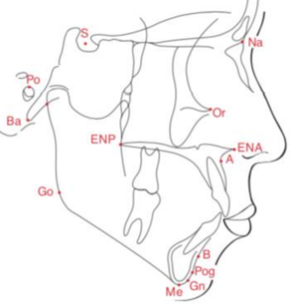
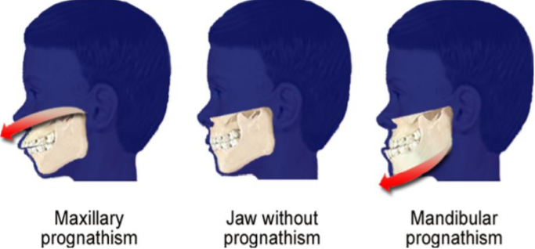

Cephalometry
What is cephalometry?
The study and measurement of the skull including different landmarks and several angles.
Why we need that?
In clinical contexts, quantified landmarks and angles measures the deformity of patients and helps diagnosis for orthodontists and maxillofacial surgeons
[3] “orthodontie de l'enfant et du jeune adulte -tome 2.” Accessed June 15, 2020. https://www.elsevier-masson.fr/ [4] “Orthognathic surgery.” In Wikipedia, February 29, 2020. https://en.wikipedia.org/

Slide 5
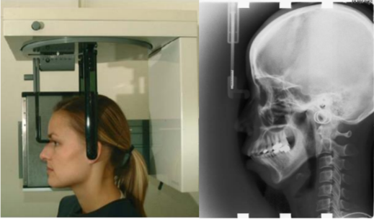
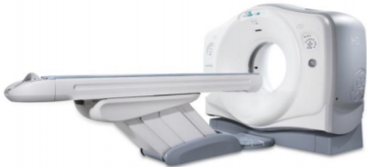
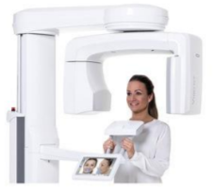
Medical imaging for cephalometry
2D imaging: Lateral cephalogram
Drawback: prone to superimposition of bilateral structure
3D imaging: CT/ CBCT
Drawback: high radiation/ no calibration
[5] “Discovery CT750 HD | GE Healthcare.” Accessed June 11, 2020. https://www.gehealthcare.com/courses/discovery-ct750-hd.
[6] “Dental CBCT Scanner - All Medical Device Manufacturers - Videos.” Accessed June 11, 2020. https://www.medicalexpo.com/medical-manufacturer/dental-cbct-scanner-28330.html.

Slide 6
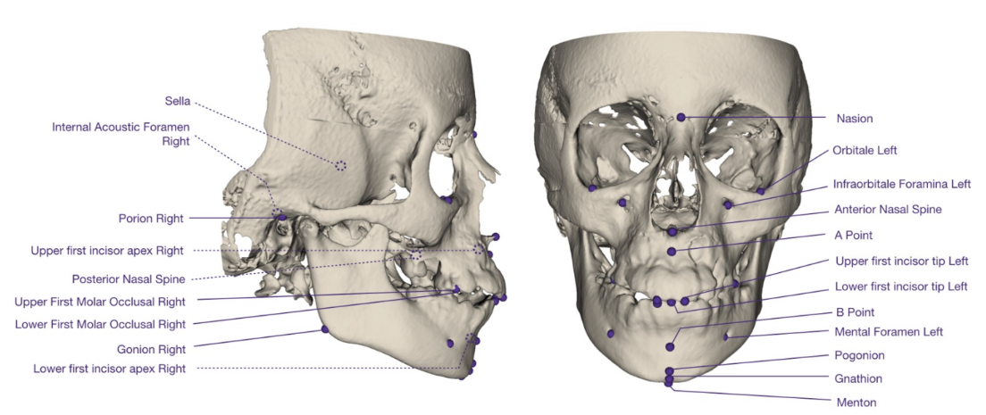
Landmarks

Slide 7
Why do we need an automated method ?
Manual landmarking requires time and a high level of expertise.
It takes up to 14 minutes to place 22 landmarks^{[7]}
Therefore, the main goal is to help doctors free from tedious annotation, making diagnosis more efficient
[7]Hassam et al,. 2013 https://doi.org/10.1093/ejo/cjr050.

Slide 8
Recent studies
Author | Year | Category | Number of landmarks | Overall Mean Error (Euclidean Distance)/mm
Neelapu et al | 2018 | Knowledge-based (symmetrical feature) | 20 | 1.88±1.10
Codari et al | 2017 | Atlas-based (K means clustering) | 21 | 2.39±1.73
O’Neil et al | 2018 | Learning-based (DF+HOG&FCN) | 22 | Observer A: 2.45 ± 2.53 Observer B: 3.49 ± 2.88
Zhang et al | 2017 | Learning-based (FCN) | 15 | 1.10
Torosdagli et al | 2019 | Learning-based (FCN & LSTM) | 9 | <1.0 (7 out of 9 landmarks)

Slide 9
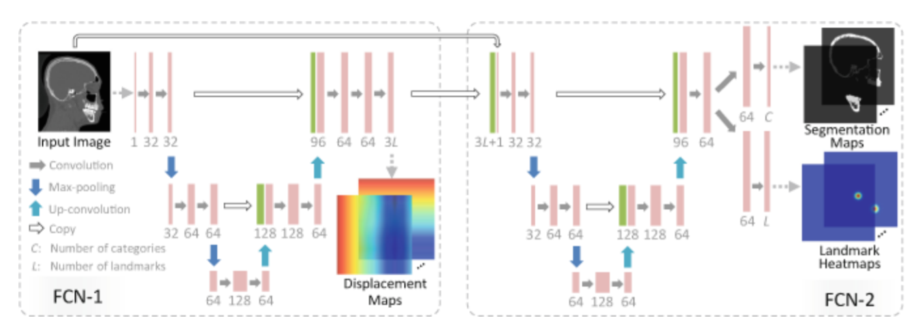
Deep learning-based methods
Zhang et al., 2017: Joint Craniomaxillofacial Bone Segmentation and Landmark Digitization by Context-Guided Fully Convolutional Networks
Dataset: 77 CBCT-scans with 5-fold cross validation
Distance error: 1.1mm(15 landmarks)

Slide 10
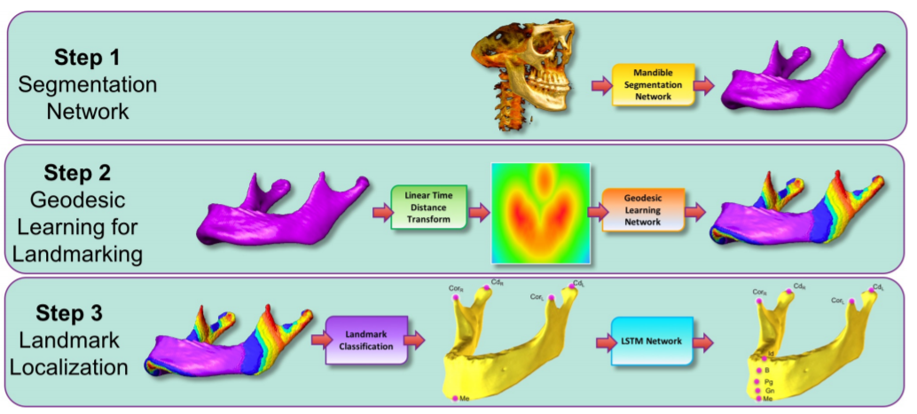
Deep learning-based methods
Torosdagli et al., 2019: Deep Geodesic Learning for Segmentation and
Anatomical Landmarking
Dataset: 50 CBCT-scans with 5-fold cross validation
Distance error: <1mm(7 out of 9 landmarks)

Slide 11
2.Materials & Methods

Slide 12
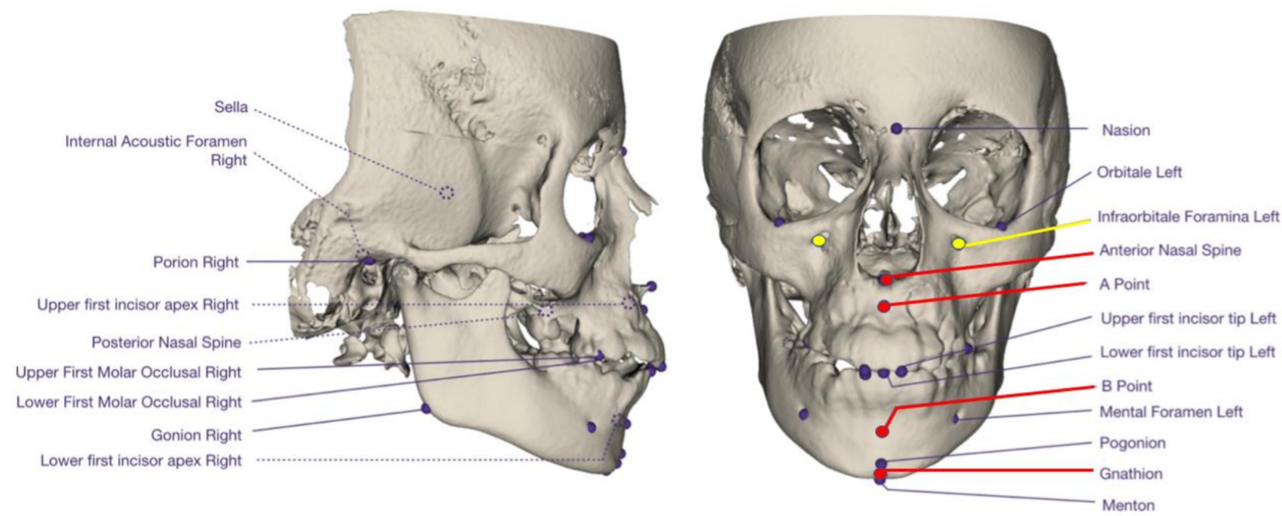
Our cephalometry database
Size: 200 subjects - 35 were selected for the presented experiment.
Slice: 512*512 pixels with pixel size range from 0.32 to 0.63mm.
Slice increment: 0.31mm or 0.5mm
Number of Landmarks: 33 - 6 selected for the presented experiment.

Slide 13
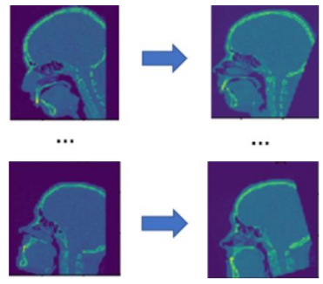
Preprocessing on the full database
Normalization
Here optional reorientation is to test if it could improve the performance of the model
Extract pixels from dicom files
Stretch gray value to [0,1]
Resize voxels to 1*1*1 mm³
Histogram Equalization
Cropping
Reorientation
Workflow
Example
[2]“Frankfurt plane baidu baike”Accessed June 11, 2020. https://baike.baidu.com/

Slide 14
Deep learning experiments
The following experiments were based on 35 subjects out of 200 subjects.
35 subjects are further divided as 32 for training set and 3 for test set.
6 out of 33 landmarks selected for evaluation.
No cross validation in following experiments.

Slide 15
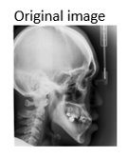
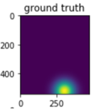
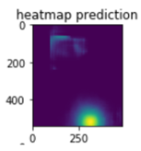
How to localize landmarks? With heatmaps!
We generated a Gaussian probability heatmap for each landmark with the voxel intensity stretched to the range of [0,1].
The intensity value of each voxel represents the probability that the voxel stands for the correct position of corresponding landmark.
Numerical coordinates

Slide 16
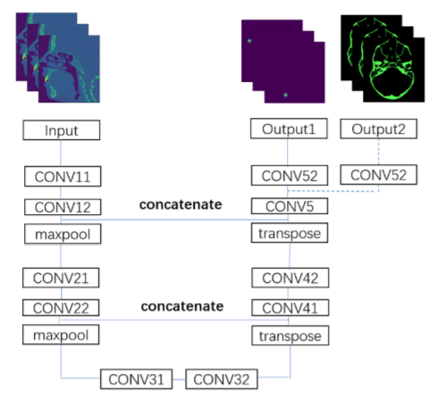
Model
Original model is a 3D U-Net with 2 concatenations
we also implement multi-task learning using segmentation

Slide 17
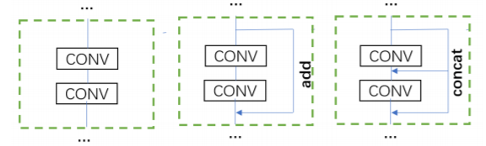
Model with shortcut connection
Other than original model, we also propose 2 shortcut-based model.
original block res block dense block
3D U-Net
3D Res U-Net
3D Dense U-Net

Slide 18

Training setting
Server: Google Colab
Memory: 24 GB
CPU :Intel Xeon @ 2.2GHz。
GPU:NVIDIA Tesla P100 PCIe 16 GB

Slide 19
3.Results & discussion

Slide 20
Results
Landmarks | 3D U-Net | 3D Res U-Net | 3D Dense U-Net
A | 2.35 ± 0.96 | 1.32 ± 0.49 | 1.79 ± 0.62
ANS | 1.13 ± 0.25 | 1.13 ± 0.33 | 1.26 ± 0.56
B | 1.67± 0.73 | 1.70 ± 0.66 | 3.43 ± 1.71
Gnathion | 1.72 ± 0.84 | 0.90 ± 0.18 | 1.81 ± 0.84
IF left | 1.74 ± 0.92 | 1.95 ± 0.84 | 1.95 ± 0.96
IF right | 2.72 ± 1.43 | 3.16 ± 1.56 | 2.23 ± 1.03
total | 1.88 ± 0.83 | 1.69 ± 0.74 | 2.07 ± 0.91
Landmarks | 3D U-Net | 3D Res U-Net | 3D Dense U-Net
A | 2.45 ± 0.96 | 1.50 ± 0.69 | 1.72 ± 0.60
ANS | 1.23 ± 0.25 | 1.28 ± 0.33 | 1.20 ± 0.53
B | 1.75± 0.73 | 2.05 ± 0.71 | 3.33 ± 1.68
Gnathion | 1.80 ± 0.84 | 0.95 ± 0.23 | 1.75 ± 0.82
IF left | 1.82 ± 0.92 | 2.00 ± 1.04 | 1.85 ± 0.88
IF right | 2.82 ± 1.43 | 3.38 ± 1.56 | 2.21 ± 0.92
total | 1.97 ± 0.92 | 1.89 ± 0.84 | 2.01 ± 0.86
with
reorientation
with segmentation
For original model, Anterior Nasal Spine (ANS) has the lowest value of 1.13 ± 0.25 mm and Infraorbital Foramen Right (IF right) has the highest value of 2.72 ± 1.43 mm.
The best model here is 3D Res U-Net with no segmentation and reorientation
Landmarks | 3D U-Net | 3D Res U-Net | 3D Dense U-Net
A | 2.50 ± 1.04 | 2.18 ± 0.96 | 2.6 ± 1.06
ANS | 1.59 ± 0.81 | 1.86 ± 0.75 | 1.92 ± 0.43
B | 3.76± 1.85 | 4.18 ± 2.16 | 3.19 ± 1.54
Gnathion | 0.99 ± 0.43 | 1.64 ± 0.56 | 2.25 ± 0.86
IF left | 1.83 ± 0.66 | 1.82 ± 1.03 | 2.04 ± 0.79
IF right | 2.95 ± 1.37 | 3.28 ± 1.56 | 2.43 ± 0.99
total | 2.27 ± 0.96 | 2.49 ± 1.22 | 2.40 ± 0.98

Slide 21
Results
By multi-task learning we also segment the skulls in the meantime
Bones | Metrics | 3D U-Net | 3D Res U-Net | 3D Dense U-Net
Mandible | Pixel Accuracy | 0.994 | 0.995 | 0.995
 | Dice coefficient | 0.903 | 0.903 | 0.903
Upper skull | Pixel Accuracy | 0.990 | 0.990 | 0.991
 | Dice coefficient | 0.899 | 0.900 | 0.901
For both segmentation mask, 3D Dense U-Net achieved the best performance, slightly better than 3D Res U-Net and 3D U-Net.
Segmentation performance for mandible was slightly better than upper skull.

Slide 22
Conclusions
In preliminary results, guidance of segmentation and reorientation don’t help landmarks localization
Landmarking error with 1.67 ± 0.74 mm and segmentation performance with pixel accuracy of 99% still show the overwhelming power of deep learning based method
3D Res U-Net seems the most suitable model so far but it will still be checked afterwards.

Slide 23
Computation facilities
Cluster : Bio-fractal
Memory: 128 GB
CPU :AMD Ryzen 9 3900X 12-Core Processor
GPU:NVIDIA RTX TITAN 24 GB*2

Slide 24
Future work
Our test will be extended to the whole dataset.
Higher resolution of images could be used.
Hyperparameters optimization will be done with better facility.

